Slide 1
Drupal Installation on Debian OS using LINUX commands

Slide 2
With ssh, follow these directions (copy and paste when necessary & remember to use the tab and arrow keys!):
Run:
aptitude install drupal7
Once this is successful, you will need to configure the package

Slide 3
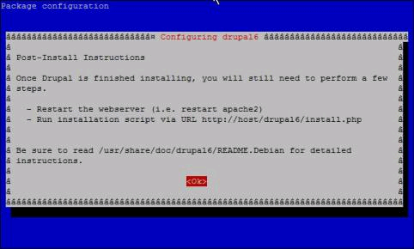
Installing Drupal7 (Please note these images are for Drupal6, but are basically the same):
Simply follow the series of prompts, choosing:
“OK” after you have read the post-install instructions
“Yes” to configure the database

Slide 4
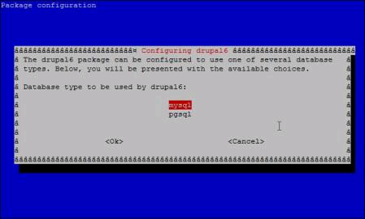
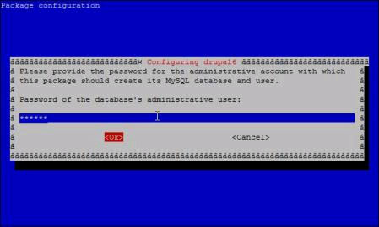
Installing Drupal7
Choose:
“mysql” to select the database type
the password for the administrative account

Slide 5
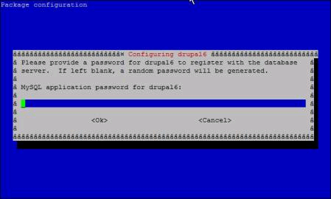
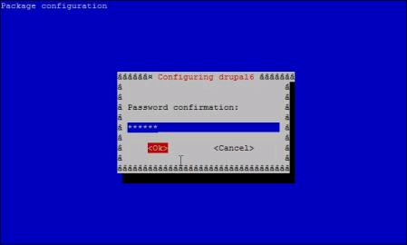
Installing Drupal7
the password for the database server
type in the password again to confirm

Slide 6
With ssh, follow these directions (copy and paste when necessary & remember to use the tab and arrow keys!):
After installation is successful, use these commands:
(documentation located in /usr/share/doc/drupal7)...read by using command zcat README.Debian.gz
ln -s /etc/drupal/7/apache2.conf /etc/apache2/conf.d/drupal7.conf
/etc/init.d/apache2 restart
Point your browser to http://server.openlib.org/drupal7/install.php and follow steps to configure your site.
(Replace server with the name of your server.)

Slide 7
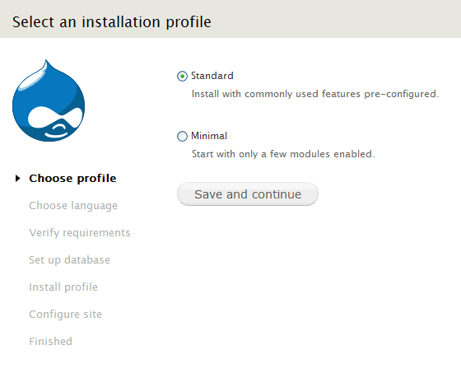
Congratulations!!
Just follow the directions to finish your drupal site!

