Slide 1
Open Source Integrated Library System
Patron Categories
Ability to organize patrons into:
different roles (staff, patron, student, juvenile, etc.)
age groups (age requirement)
patron types (adult, child, staff, organization, professional or statistical)

Slide 2
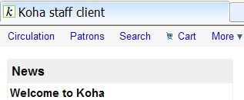
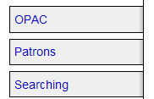
First we need to enable the enhanced messaging preferences (allows the patron to specify advance notifications for items due, items on hold, etc.) follow these links:
Global System Preferences
More (at top of page)
Administration
Global System preferences (under Koha Administration
Patrons (tab on left)
EnhancedMessagingPreferences -choose allow and scroll down and click on Save all Patron preferences

Slide 3
Now follow these links to add a new category:
Administration (at top of page next to Home)
Patron categories (listed under Patron and Circulation)

Slide 4
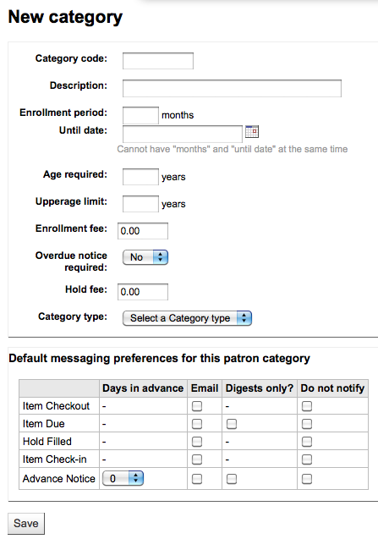
Adding a patron category
Click the New Category tab at the top of the page

Slide 5
Adding a patron category
Category code is an identifier
(limited to 10 characters-numbers or letters, ie INT)
Description
(plain text version of the category code, ie Intern)
Enrollment period (in months) should be filled in for limited enrollment period (possibly for student cards that expire after a certain date) only fill in Enrollment period OR Until date

Slide 6
Adding a patron category
Age required-some patron categories can have a minimum age (in years) requirement associated with them
Upperage limit-maximum age (in years) associated with them (children)
Enrollment fee-if you charge a membership fee for your patrons (such as those who live in another region)
Enter only numbers and decimals

Slide 7
Adding a patron category
Overdue Notice required-If you want your patron to receive overdue notices, set to 'Yes'
Hold fee-If you charge patrons for placing holds on items, enter the fee amount
Enter only numbers and decimals
Category type-Choose one of the six main parent categories from the pull-down menu

Slide 8
Advanced messaging preferences
Default messaging preferences for this patron category-(Item checkout, Item DUE, Hold Filled and Item Check-in)
These can be changed for individual patrons and applies to certain kinds of notices.
Overdue notices will be sent based on the library’s rules, not the patron’s choice.
Click on Save at the bottom of the page

Slide 9
Edit or Delete a Patron Category
Patron Category Administration page:
Click on Edit or Delete next to the Patron Category and follow as necessary

Slide 10
Patron Attribute Types
Ability to define additional fields to associate with patron records that are not included in the default patron category options
(ie, associate a driver’s license number with a patron’s record)

Slide 11
Enable the extended patron attributes (to define custom fields associated with patron records) follow these links:
Global System Preferences
System Preferences (left side bar)
Patrons (tab on left)
ExtendedPatronAttributes -choose enable and scroll down and click on Save all Patron preferences

Slide 12
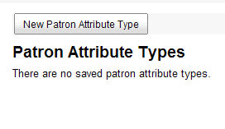
Now follow these links to add a new patron attribute type:
Administration
(at top of page next to Home)
Patron attribute types
(listed under Patron and Circulation)

Slide 13
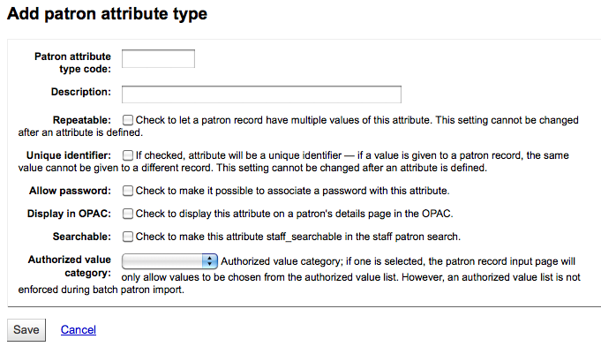
Adding patron attributes
Click the New Attribute Type tab at the top of the page

Slide 14
Adding a patron attribute
Patron attribute type code is an identifier
(limited to 10 characters-numbers or letters, ie STUID)
Description
(plain text version of the attribute code, ie Student ID) Check the box next to “Repeatable” to allow a patron record to have multiple values of this attribute
Unique identifier should be checked to establish a unique identifier, so if a value is given to a patron record, the same value cannot be given to a different record.

Slide 15
Adding a patron attribute
Check allow password to associate a password with this attribute
Display in OPAC
to display this attribute on a patron’s details page in the OPAC
Check Searchable to make this attribute searchable in the staff patron search.

Slide 16
Adding a patron attribute
If one of the Authorized value category options is selected, the patron record input page will only allow values to be chosen from the authorized value list.
Authorized values restrict the values that catalogers can place in some MARC tag indicators and MARC subfields. (explained in later slides)
Click on the Save tab to submit the new patron attribute.

Slide 17
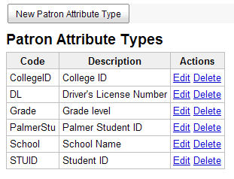
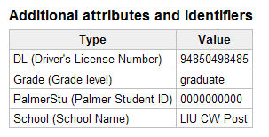
Adding a patron attribute
The new attribute will appear on the list of attributes and on the patron record add/edit form (can be found by searching a patron’s record)
(List of attributes with additional attributes now included)
(Example from an individual patron record)

Slide 18
Edit or Delete a Patron Attribute
Click on Edit or Delete next to the Patron Category and follow as necessary
Some fields cannot be edited once created:
Patron attribute type code
Repeatable
Unique Identifier
If an attribute is in use, you will be unable to delete it.

Slide 19
Adding an authorized value category
Click on the link “Authorized values” on the left sidebar.
Click on the New category button
Category-limit Category to 11 characters (with meaning)
Authorized value-enter a code
Description-describe value entered
Click Save
The new category and value will appear on the list of Authorized Values.

Slide 20
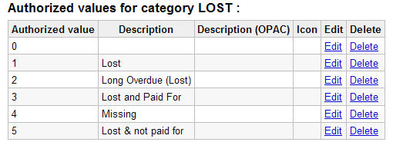
Adding a new authorized value
To add a new authorized value to any existing or new category:
Click on the New Authorized value for xyz
Authorized value-enter a code
Description-describe value entered
Click Save
The new value will appear on the list along with existing
values
(In this example,
5 Lost & not paid for
was added as an authorized value)

